Slide 1
Rethinking human vulnerabilities in cybersecurity
David Modic
Notes:
What does a janitor say when they jump out of a Closet? SUPPLIES!

Slide 2
The humble brag slide
At this point of time, speakers waste your time with details only their mothers (barely) care about.
My name is on every slide. If you desperately need to know about my credentials, google me :).
Be aware that there is little, to no, peer review in advert pages. Even my Wikipedia page for a long time listed my hobbies as: (1) herding cats and (2) retro-phrenology.
david.modic@fri.uni-lj.si
Notes:
This is a talk about trying to find logic in a world gone mad.
What I mean by that is that we keep finding ourselves in situations that are bonkers, and if we point out that they are bonkers, people around us act as if we are insane. Let me give you an example.
UNDERGRAD.
WINTER.
LOG CABIN.
EMOTIONAL DIFFICULTIES.
STOVE.
CAN OF COKE.
ReTURN. My MOTHER.

Slide 3
What am I even talking about?
This is a talk about ...
To illustrate my point: Years ago, I was roped into going on a trip to a cabin in the woods, with a group of kids from a juvenile home…
“If people keep telling you that you are insane, just lean into it, stop fighting it”.
This helps a lot, when working with the industry.
I just accept that governing boards think I am insane. They will still have to follow my advice.
david.modic@fri.uni-lj.si
Notes:
This is a talk about trying to find logic in a world gone mad.
What I mean by that is that we keep finding ourselves in situations that are bonkers, and if we point out that they are bonkers, people around us act as if we are insane. Let me give you an example.
UNDERGRAD.
WINTER.
LOG CABIN.
EMOTIONAL DIFFICULTIES.
STOVE.
CAN OF COKE.
ReTURN. My MOTHER.

Slide 4
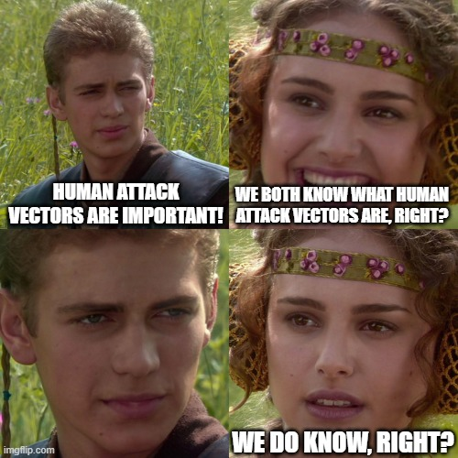
Human Attack Vectors
We all know what human attack vectors are.
But do we? Everyone?
About half a year ago, there is a progress meeting for a Defense project…
My point is that a HAV is like Aspirin™ . Everyone sort of understands what it does, but very few people understand how it actually works.
david.modic@fri.uni-lj.si
Notes:
In the meeting, I am asked to substantiate attacks against human targets in a particular defense scenario. I have previously been forbidden to discuss them by the consortium leader, because “presenting viable attacks against defense personnel might put their security clearance in jeopardy”. I did point out at the time, that if their OPSEC is that bad, then perhaps their security clearance should be in jeopardy. But that point comes later. In this presentation.
Now, a year later, I am asked to quickly run through seven proposed attacks, based gathered OSINT of actual targets. Because these are all people who work in some sort of security. I only focused on particulars that interest me. So I start by saying that Human Attack Vectors are not the most frequent attacks vectors, but they are the most effective.
A consortium member, a ceo of an SME military contractor, says. “Stop! Please define human attack vectors.”
“Fine. I mean you could google it, but I shall do the work for you. Human Attack Vectors are, simply put, those vectors where human beings are exploited or manipulated to achieve unauthorized access to some sort of electronic device, mostly computers”.
“But then hackers ultimately exploit machines, right?”
“Yes, but they gain access through exploiting humans”
“I disagree with your definition, because you ultimately attack machines”.
“… (I am stumped for a bit). Well, ok, I am sorry you disagree, but this is not my definition. Shall we find it on Wikipedia, so you can edit it and tell the world that it is mistaken because it does not fit into your fantasies?”

Slide 5
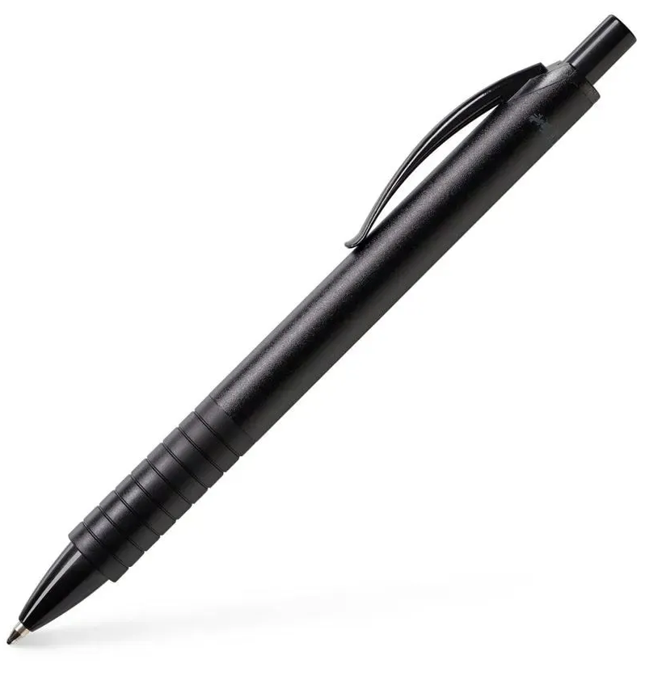
Our approach to human attack vectors is coloured by:
Illusory superiority. Let me demonstrate.
Does anyone not know what this is? Raise your hand, if you do not know.
It is a ballpoint pen. Duh.
david.modic@fri.uni-lj.si
Notes:
We think that we understand more than we actually do. The simplest demonstration is one that I got from a presentation, years ago. The presenter showed us all a ball point pen. He

Slide 6
Illusory superiority II.
Do you know how it works? Raise your hands if you do.
Of course we do, we all know, right?
If you are like me, then you are thinking about the little ball at the end of the tube that rolls in ink and leaves a trace on paper. At least that is what I thought, when I was first asked.
david.modic@fri.uni-lj.si
Notes:
We think that we understand more than we actually do. The simplest demonstration is one that I got from a presentation, years ago. The presenter showed us all a ball point pen. He

Slide 7
Illusory superiority III.
But that is not the whole story.
How does the mechanism to extend the tip work? I honestly do not know. I opened it, and still … ☺.
I do not know whether gravity exerts force on the ink, or whether there is some other mechanism.
I have no idea, what the ink consists of.
I do not know what material the ball is made of.
david.modic@fri.uni-lj.si
Notes:
We think that we understand more than we actually do. The simplest demonstration is one that I got from a presentation, years ago. The presenter showed us all a ball point pen. He

Slide 8
Illusory superiority IV.
And that is my point. Much like with the ballpoint pen example, illusory superiority means we believe we have superior understanding of things we are only sort of, vaguely familiar with.
david.modic@fri.uni-lj.si
Notes:
We think that we understand more than we actually do. The simplest demonstration is one that I got from a presentation, years ago. The presenter showed us all a ball point pen. He

Slide 9
Illusory Superiority and (Human) Security
The same principle applies to much of the population, when we talk about Human Attack Vectors.
Everyone is sure what they are, but many struggle with finer detail.
I mean, yes, exploiting human beings to gain access, fine.
But how does exploitation work? What is effective, what is not? Which psychological mechanisms elicit compliance in different contexts?
david.modic@fri.uni-lj.si
Notes:
I mean, yes, exploiting human beings to gain access, fine (even though even that is a struggle to understand for some folks). But how does exploitation work? What is effective, what is not? Which psychological mechanisms elicit compliance in different contexts. That, most of the population does not know. And yet, they still know that “human is the weakest link”.
That, most of the population does not know. And yet, they still know that “human is the weakest link”.

Slide 10
Human security and avoidance
Because we think we have full understanding of Human Attack Vectors, but most of us do not, we do what humans usually do, when facing scary things we do not understand.
We just ignore them. Evolutionary psychology FTW.
Same Defense project mentioned previously. The representative of an EU MOD says to me: “Ok, you have convinced us that Human Attack Vectors exist and are effective. What if we forbid you to create attacks, and instead just agree that your attacks would be successful? Is there a point in us trying to defend from it?”
david.modic@fri.uni-lj.si
Notes:
We just ignore them. Evolutionary psychologists will tell you that that is the reason why humans and small animals sleep at night. Since our ancient ancestors did not know what could be hiding in the dark and did not know how to protect themselves from the unknown, they slept. At least they would die unawares, right?
Well, yes there is a point. Usually research projects require some sort of research, that somewhat peskily requires some sort of proof. It is not very scientific if we just agree with convincing individuals.

Slide 11
Being comfortable in our ignorance
We are closing to 20 minutes, so let me just make this last argument.
Even security experts, and especially “security experts” are sometimes misled.
Let me refer you to the same Defense project one last time.
The consortium wants to continue the work, but we are parting ways, because no one enjoys doing nothing for years and then being paid 8 months after the due date, since the consortium leader cannot be bothered to invoice EDA sooner…
david.modic@fri.uni-lj.si
Notes:
There is another person who is really annoyed by the consortium leader. We are both security experts, but from different institutions. We work well together.
The consortium leader says that their institution will not accommodate for any kind of security testing or intelligence sharing and that “you are on your own. Do any attacks you like and present us with the results, but we will not officially allow you to do anything, not even passive intelligence gathering”.
I give up at that time, because these asshats are not worth my time, but my colleague gets really annoyed. And tells them that fine, he will find out where the product we are supposed to test will be and then find ways to destroy it. No pesky human security stuff (that the consortium leader really hates as has become apparent through this presentation), just a bomb that will destroy the device”
There is a bit of silence, that I use to finally get something.
I say to the colleague, let’s call them Urban: “How will you find out where the device is?”
“What do you mean?”
“I mean that you watch too many movies!”

Slide 12
Being comfortable in our ignorance
Even security experts sometimes think that life is a movie.
Almost no one in real life says “My sources are telling me that the target will walk through the graveyard at 3:10am on Thursday and will stop at an unmarked grave at the following GPS coordinates”.
This is what we tend to forget. We are these “sources”. No one tells security folks this stuff, because it is our job to find it out. And we do it through exploitation of human and mechanical attack vectors. But mostly human.
david.modic@fri.uni-lj.si

Slide 13
The point
Last slide ☺.
If we could just get over ourselves and acknowledge we all work together towards the same goal, and that everyone’s expertise is just that, expertise, we would get along so much easier.
If we could just get over our fragile egos and understand that the problems we are ill equipped to handle do not go away if we ignore them, my life would be much less stressful.
david.modic@fri.uni-lj.si

